Slide 1
Romans 1:16-17

Slide 2
¹⁶ For I am not ashamed of the gospel, for it is the power of God for salvation to everyone who believes, to the Jew first and also to the Greek. ¹⁷ For in it the righteousness of God is revealed from faith for faith, as it is written, “The righteous shall live by faith.”

Slide 3
I’m eager to preach the Gospel
Because I’m not ashamed of the Gospel
Because it is the power of God for salvation to everyone who believes
Because in the Gospel, the righteousness of God is being revealed
Reasons why some are ashamed of the Gospel:
Unbelievable
Offensive
Exclusive
May seem irrelevant
May seem insignificant
^{Luke 9:26} For whoever is ashamed of me and of my words, of him will the Son of Man be ashamed when he comes in his glory
The power of God to save - Dynamite!!!

Slide 4
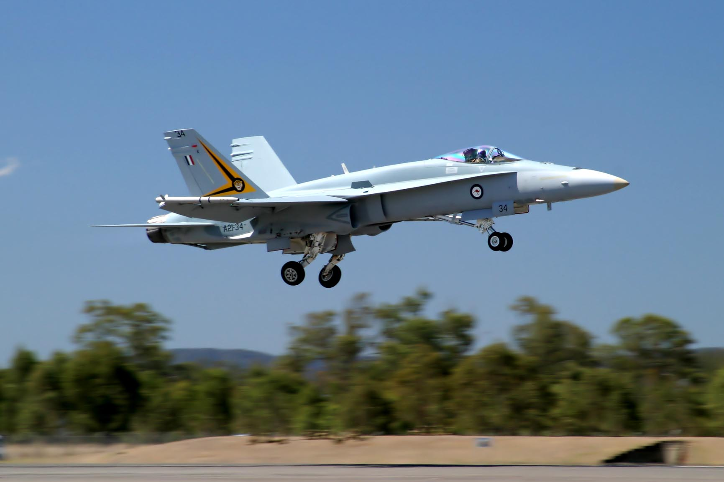

Slide 5
I’m eager to preach the Gospel
Because I’m not ashamed of the Gospel
Because it is the power of God for salvation to everyone who believes
Because in the Gospel, the righteousness of God is being revealed
Reasons why some are ashamed of the Gospel:
Unbelievable
Offensive
Exclusive
May seem irrelevant
May seem insignificant
^{Luke 9:26} For whoever is ashamed of me and of my words, of him will the Son of Man be ashamed when he comes in his glory
The power of God to save - Dynamite!!!
Only God has the POWER to save. He can save everyone.
Not everyone will be saved. Only those who have faith in Him (believe / trust)
We can’t earn salvation, because that’s not the Gospel
Self-righteousness is ugly – false, hypocritical, self-glorifying
The righteousness of God – true, beautiful, glorifies God

Slide 6
I’m eager to preach the Gospel
Because I’m not ashamed of the Gospel
Because it is the power of God for salvation to everyone who believes
Because in the Gospel, the righteousness of God is being revealed
Reasons why some are ashamed of the Gospel:
Unbelievable
Offensive
Exclusive
May seem irrelevant
May seem insignificant
The power of God to save - Dynamite!!!
Only God has the POWER to save. He can save everyone.
Not everyone will be saved. Only those who have faith in Him (believe / trust)
We can’t earn salvation, because that’s not the Gospel
Self-righteousness is ugly – false, hypocritical, self-glorifying
The righteousness of God – true, beautiful, glorifies God
God has proved Himself to be “righteous”, because He has saved us
God has taken away our unrighteousness and given us the righteousness of God
The righteous shall live by faith

